Slide 1
YAML File PV Plots
(Two bunch)
Rafael Sifuentes

Slide 2
VOC Histograms

Slide 3
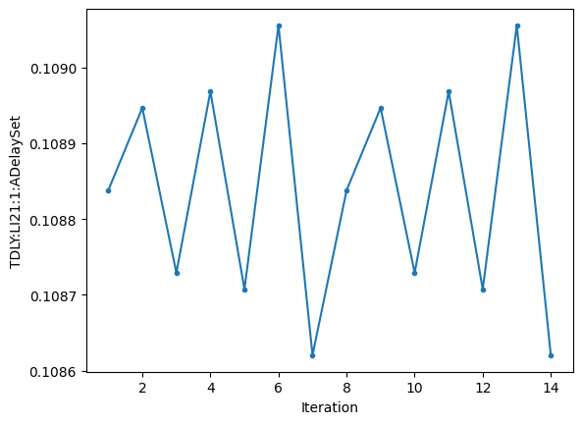
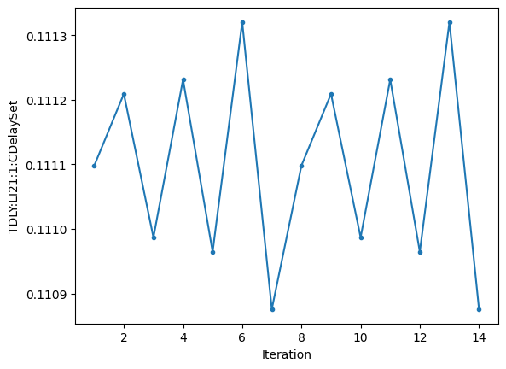
20220806_two_bunch_FEL_with_kicker_1.yaml Variables

Slide 4
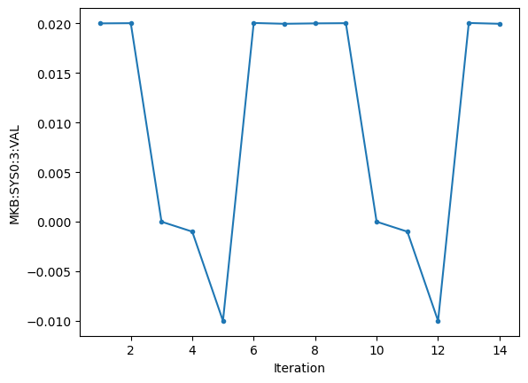
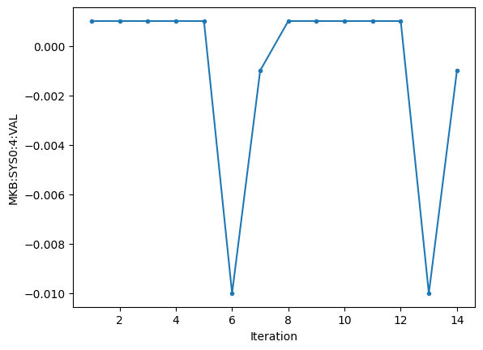
20220806_two_bunch_FEL_with_kicker_1.yaml Variables

Slide 5
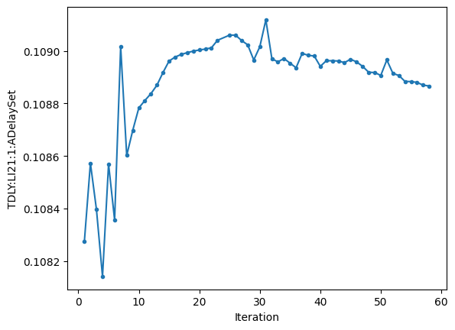
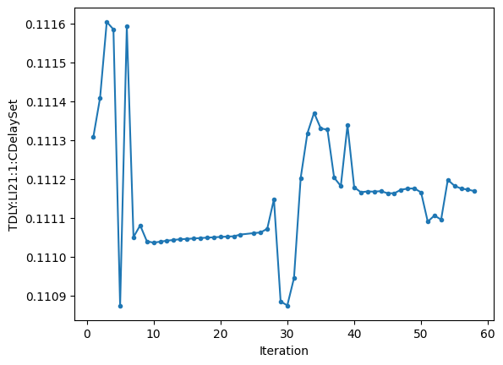
20220806_two_bunch_FEL_with_kicker_2.yaml Variables

Slide 6
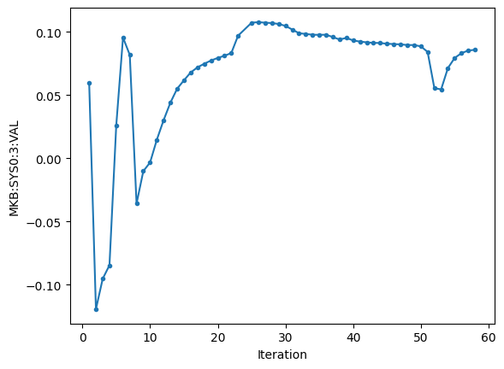
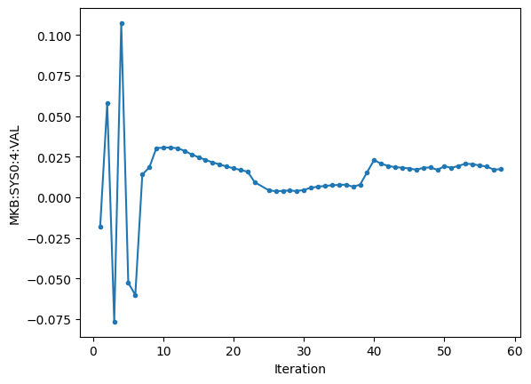
20220806_two_bunch_FEL_with_kicker_2.yaml Variables

Slide 7
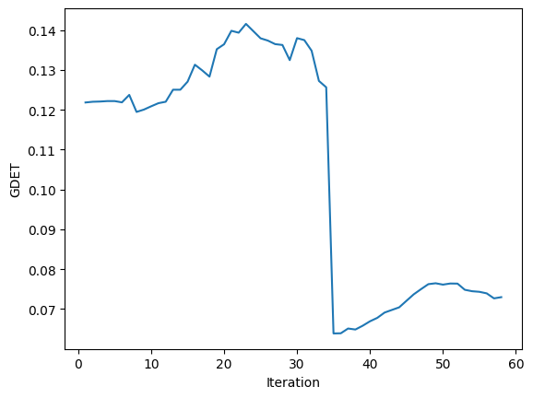
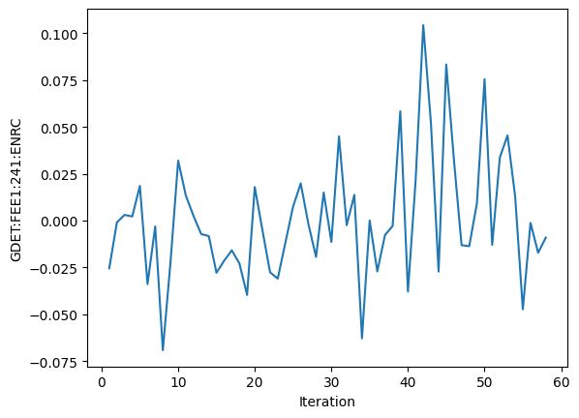
20220806_two_bunch_FEL_with_kicker_2.yaml Objective(s)

Slide 8
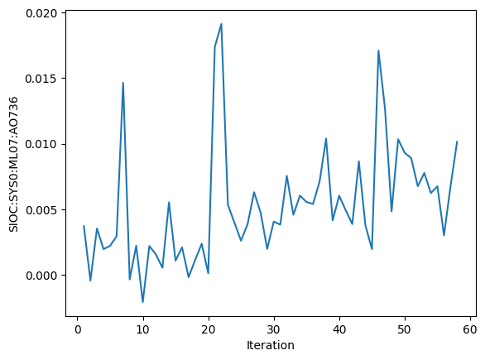
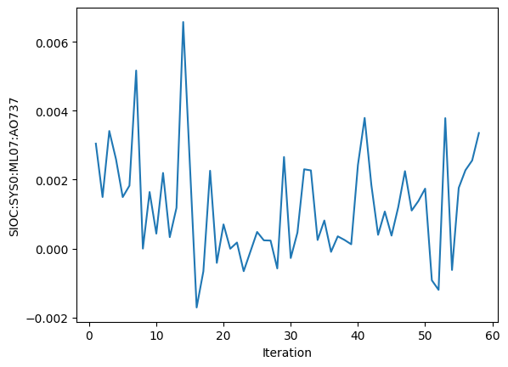
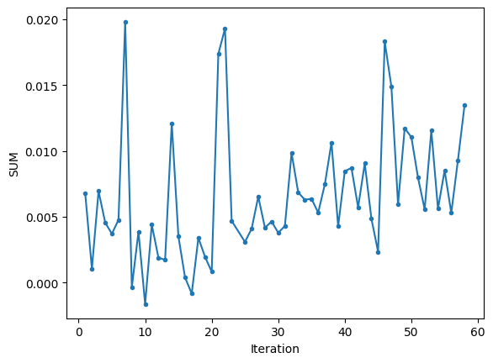
20220806_two_bunch_FEL_with_kicker_2.yaml Detectors

Slide 9
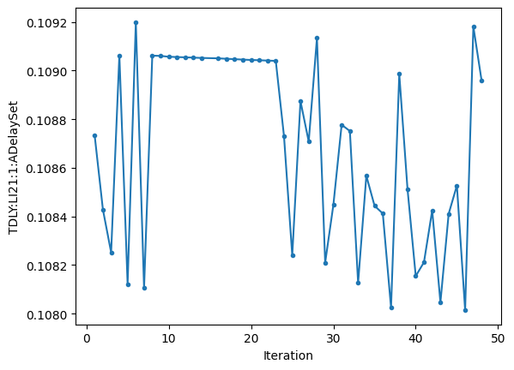
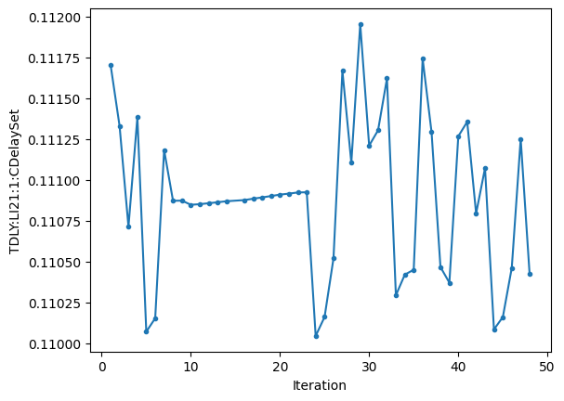
20220806_two_bunch_FEL_with_kicker_3.yaml Variables

Slide 10
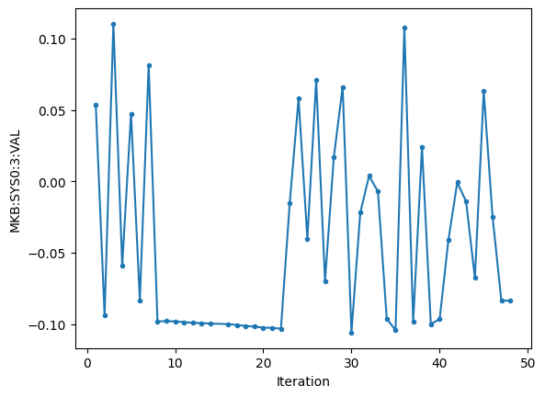
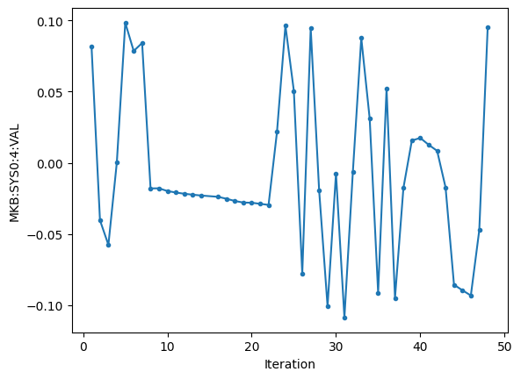
20220806_two_bunch_FEL_with_kicker_3.yaml Variables

Slide 11
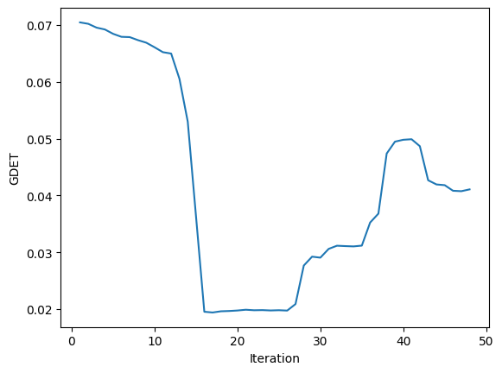
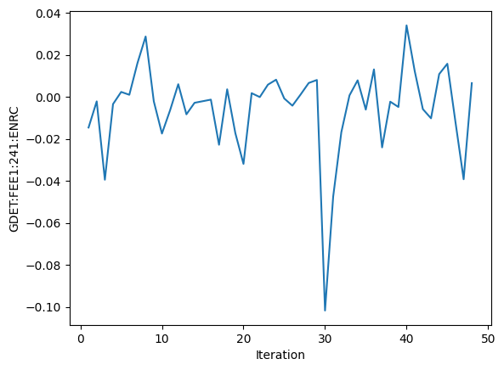
20220806_two_bunch_FEL_with_kicker_3.yaml Objective(s)

Slide 12
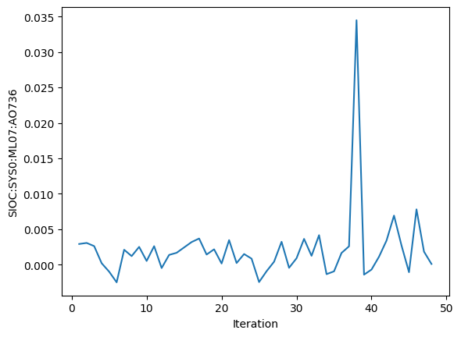
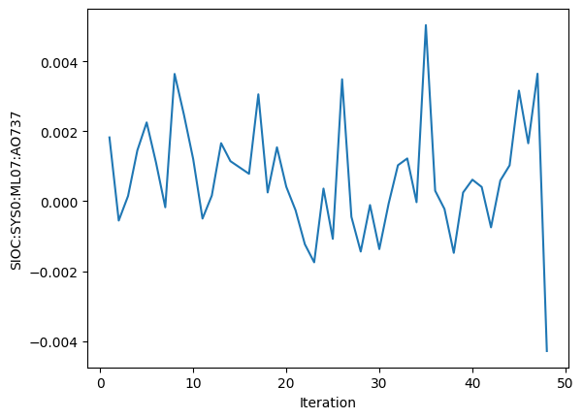
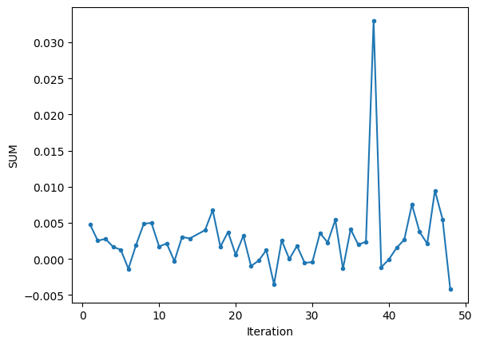
20220806_two_bunch_FEL_with_kicker_3.yaml Detectors

Slide 13
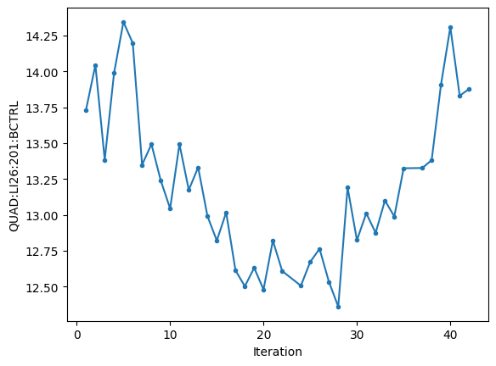
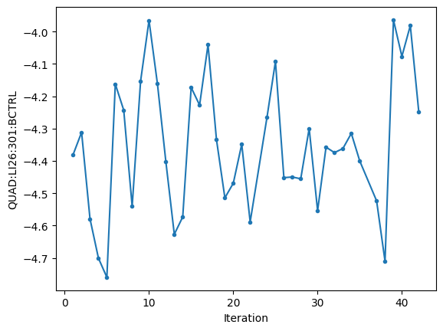
20220805_two_bunch_FEL_with_kicker.yaml Variables

Slide 14
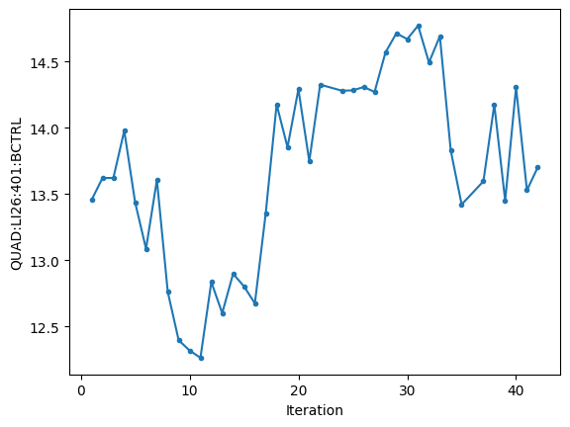
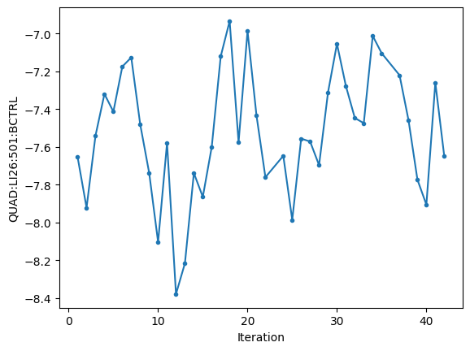
20220805_two_bunch_FEL_with_kicker.yaml Variables

Slide 15
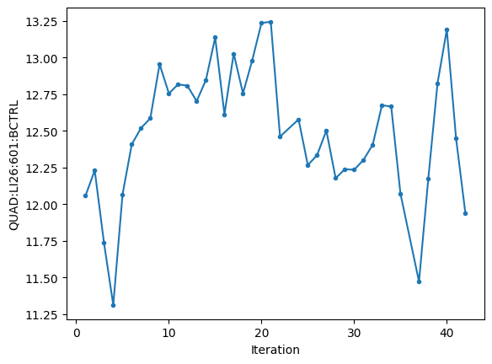
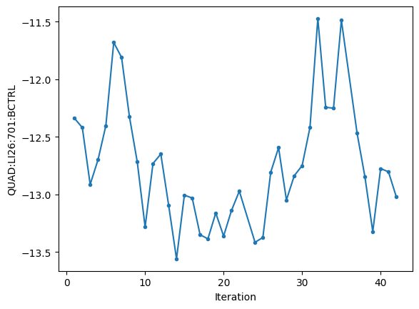
20220805_two_bunch_FEL_with_kicker.yaml Variables

Slide 16
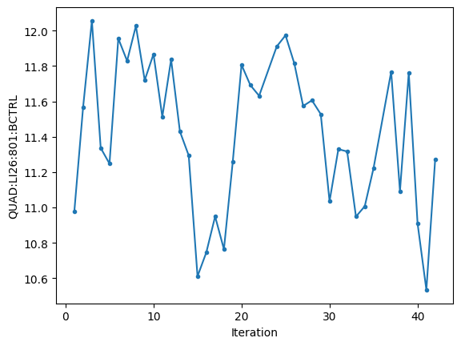
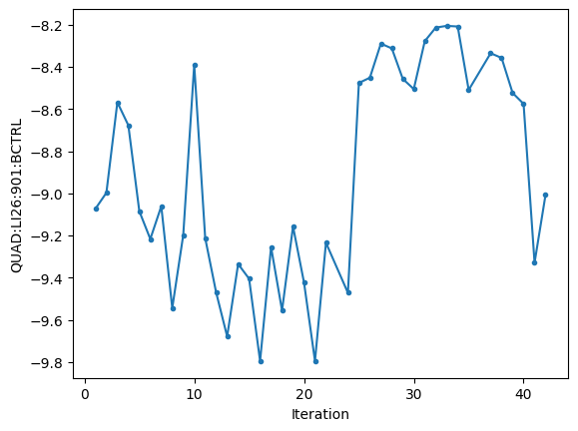
20220805_two_bunch_FEL_with_kicker.yaml Variables

Slide 17
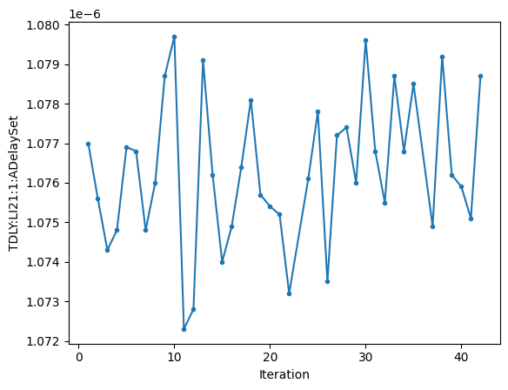
20220805_two_bunch_FEL_with_kicker.yaml Variables

Slide 18
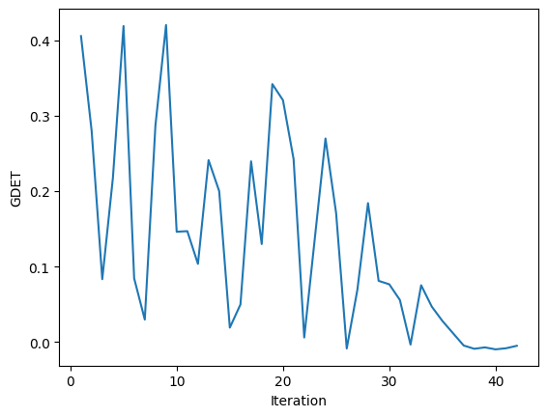
20220805_two_bunch_FEL_with_kicker.yaml Objective(s)

Slide 19
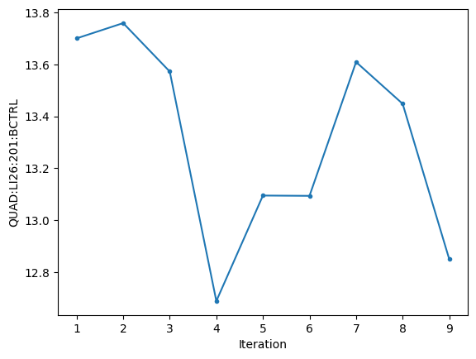
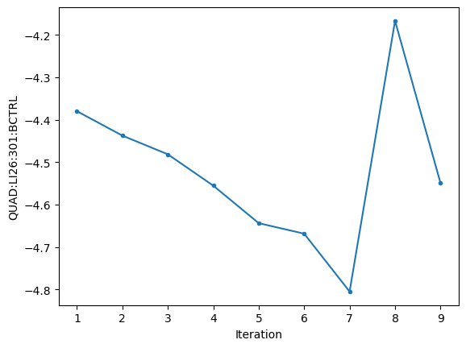
20220805_two_bunch_FEL_with_kicker2.yaml Variables

Slide 20
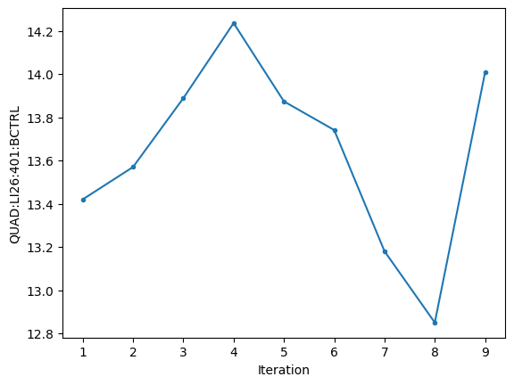
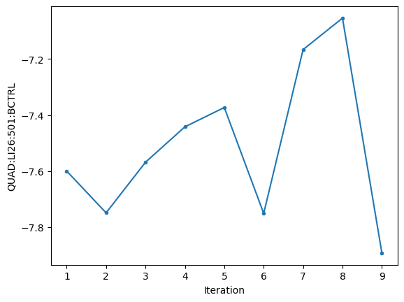
20220805_two_bunch_FEL_with_kicker2.yaml Variables

Slide 21
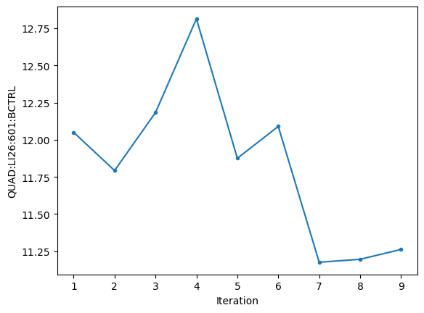
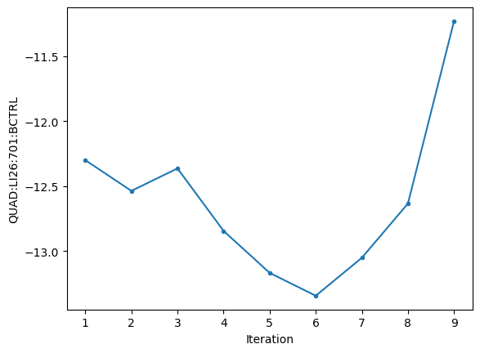
20220805_two_bunch_FEL_with_kicker2.yaml Variables

Slide 22
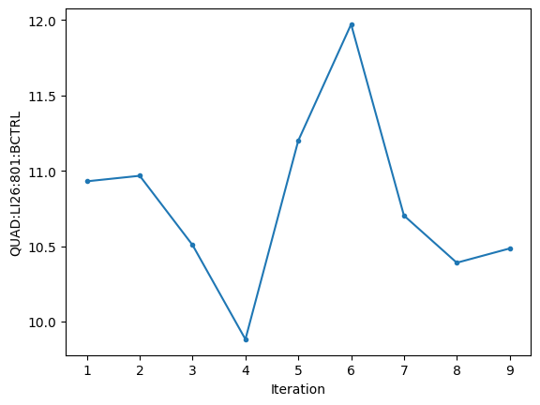
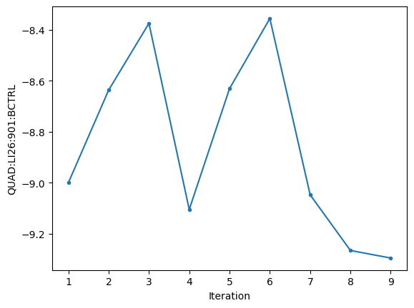
20220805_two_bunch_FEL_with_kicker2.yaml Variables

Slide 23
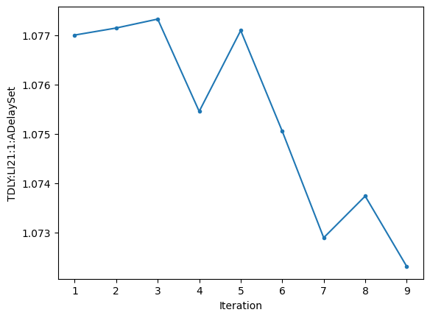
20220805_two_bunch_FEL_with_kicker2.yaml Variables

Slide 24
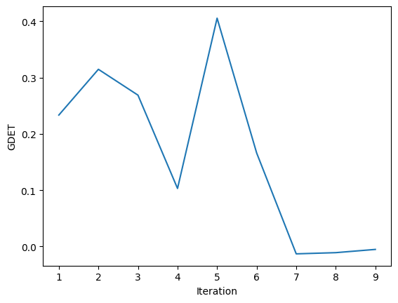
20220805_two_bunch_FEL_with_kicker2.yaml Objective(s)

Slide 25
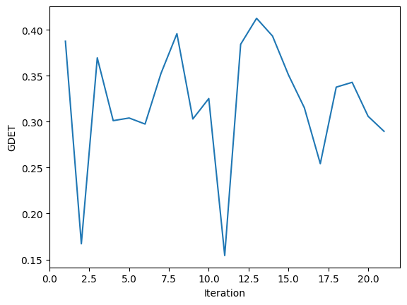
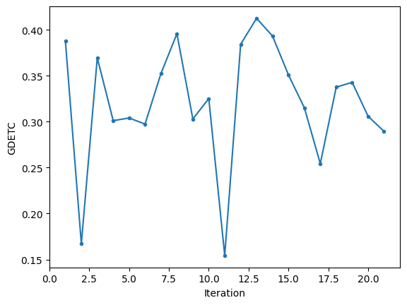
20220805_two_bunch_FEL_with_kicker_multiknob.yaml Objective(s)

Slide 26
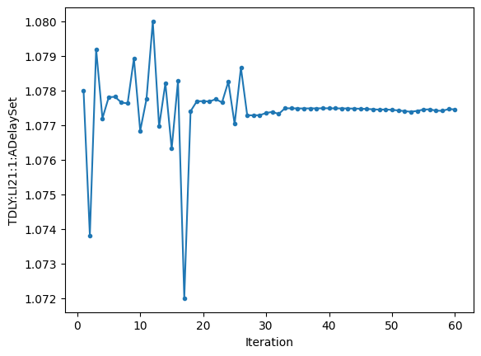
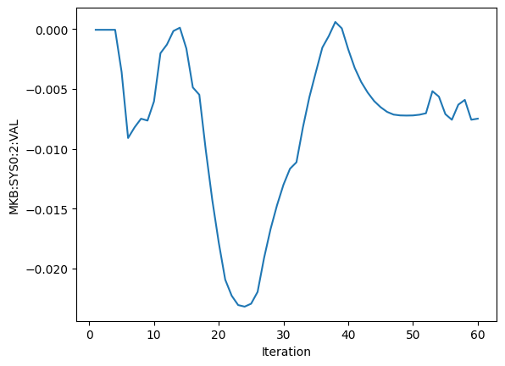
20220805_two_bunch_FEL_with_kicker_multiknob2.yaml Variables

Slide 27
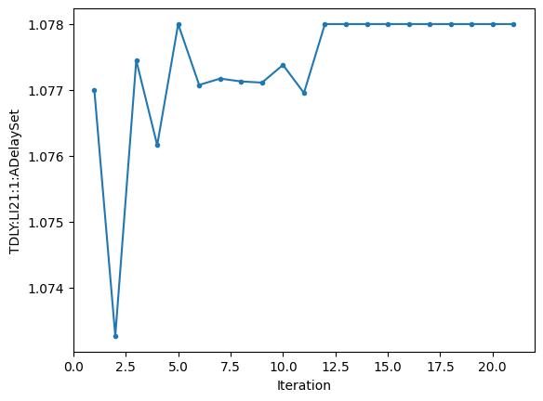
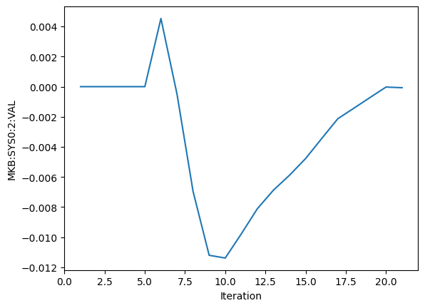
20220805_two_bunch_FEL_with_kicker_multiknob.yaml Variables

Slide 28
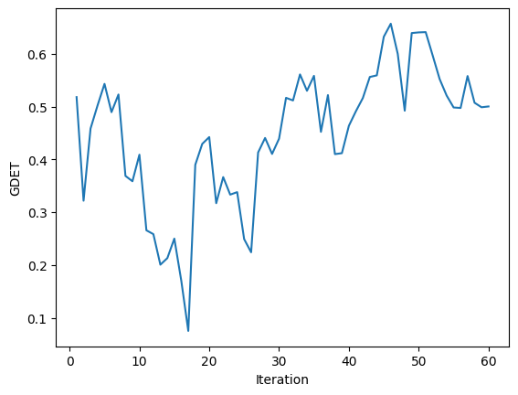
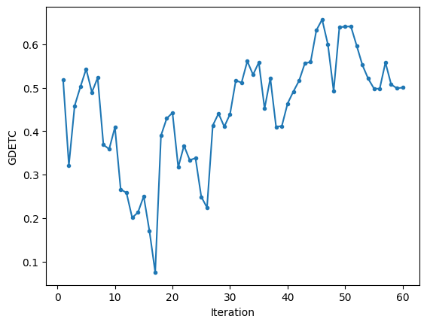
20220805_two_bunch_FEL_with_kicker_multiknob2.yaml Objective(s)

Slide 29

20220805_two_bunch_FEL_test.yaml Variables

Slide 30

20220805_two_bunch_FEL_test.yaml Objective(s)

Slide 31

20220805_two_bunch_FEL_test2.yaml Variables

Slide 32

20220805_two_bunch_FEL_test2.yaml Objective(s)

Slide 33


20220805_two_bunch_FEL_repeat_after_multiknob.yaml Variables

Slide 34


20220805_two_bunch_FEL_repeat_after_multiknob.yaml Variables

Slide 35


20220805_two_bunch_FEL_repeat_after_multiknob.yaml Variables

Slide 36


20220805_two_bunch_FEL_repeat_after_multiknob.yaml Variables

Slide 37


20220805_two_bunch_FEL_repeat_after_multiknob.yaml Objective(s)

Slide 38


20220805_two_bunch_FEL_multiknob_kicker_with_quads.yaml Variables

Slide 39


20220805_two_bunch_FEL_multiknob_kicker_with_quads.yaml Variables

Slide 40


20220805_two_bunch_FEL_multiknob_kicker_with_quads.yaml Variables

Slide 41


20220805_two_bunch_FEL_multiknob_kicker_with_quads.yaml Variables

Slide 42


20220805_two_bunch_FEL_multiknob_kicker_with_quads.yaml Variables

Slide 43


20220805_two_bunch_FEL_multiknob_kicker_with_quads.yaml Objective(s)

Slide 44

Iteration versus Time Plot

Slide 45
GP Plots

Slide 46


Slide 47


Slide 48


Slide 49


Slide 50


Slide 51


Slide 52


